Slide 1



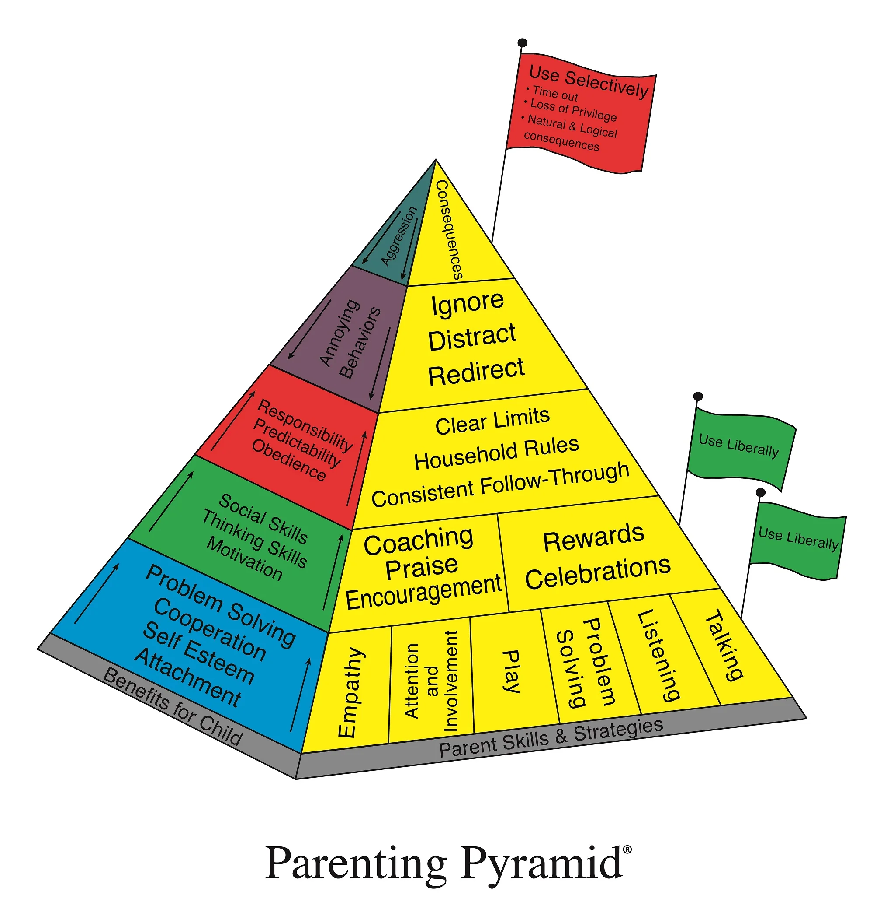

School Age Programme –
Information for parents/carers
A 13-week group for parents and carers of children in Y 1- 6
The programme aims to:
- Increase children’s social and emotional learning
- Develop children’s problem-solving skills and strategies to manage feelings of anger and upset
- Strengthen the parent/carer-child relationship
Throughout the group programme, you will:
Work on personal goals
Learn through group discussions and skills practice
Complete home activities with your child
Receive regular supportive phone calls from group facilitators
Further Information
If you are interested in attending, or have further questions about Incredible Years, please speak to your school’s Mental Health Lead.
Venues and dates across Coventry and Warwickshire

