Slide 1


Slide 2
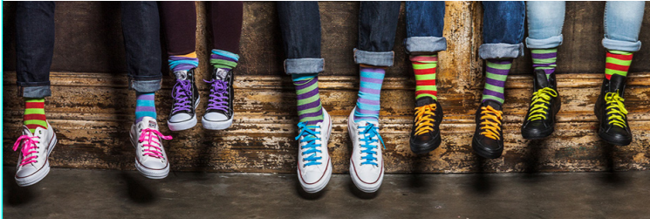
Remember last year?

Slide 3
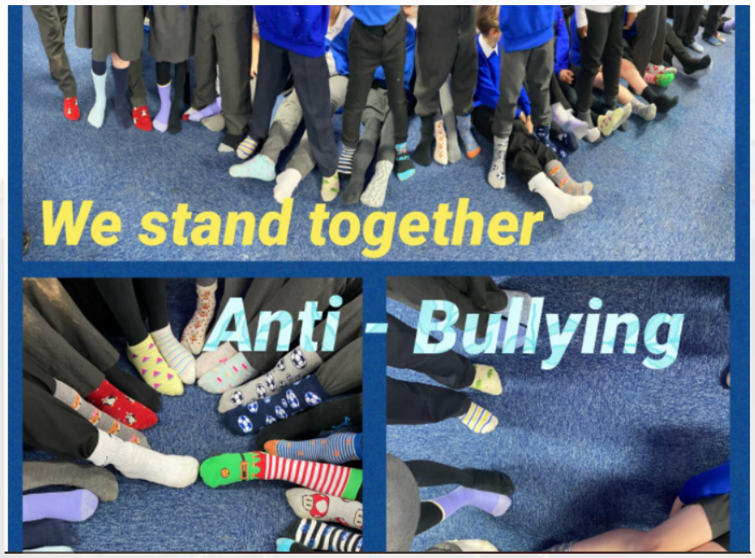
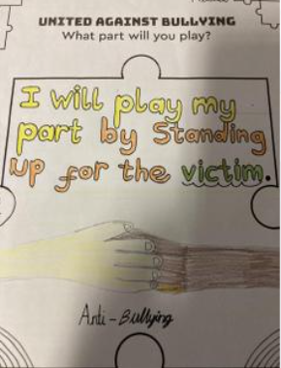
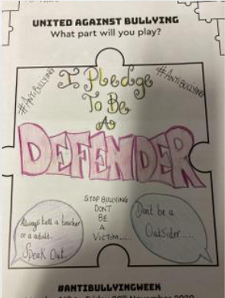
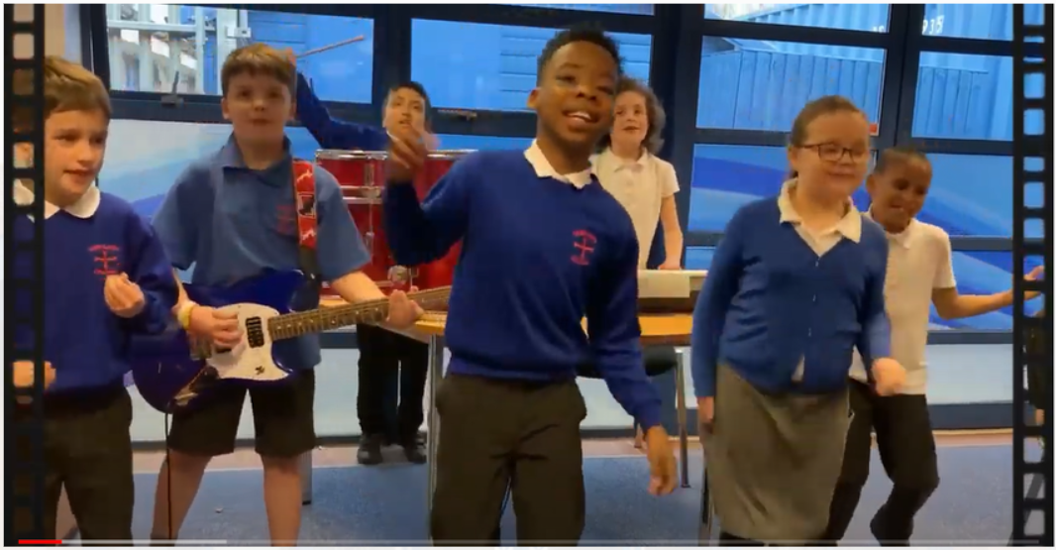
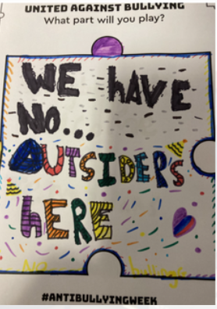

Slide 4


Anti-Bullying
Week 2021
Primary School Assembly

Slide 5
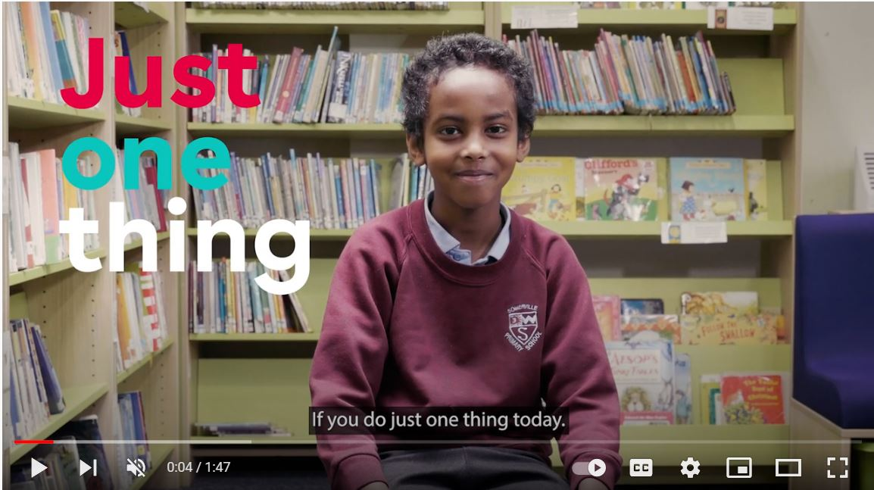


“
“
https://youtu.be/oJQg2JyQ3mM
Anti-Bullying Week 2021 – One Kind Word
5

Slide 6
I’m glad you are in my class
You make me smile
Chain
of
Kindness
I think you are a great artist
I like you!
I love your odd socks
Your turn – 2 min thinking time and then share
one kind word with the person next to you.

Slide 7

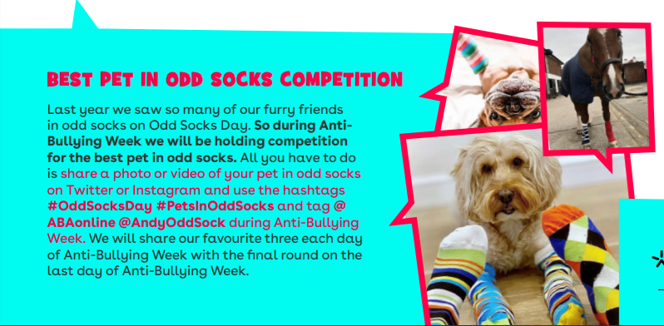
You are going to take your class photo at the end of this assembly.
Pet photos need to be sent by email to your year group email or uploaded on Seesaw.
Prize next week for the winning class and pet!

Slide 8


https://www.youtube.com/watch?v=lpZ3u5Z6pOg

Slide 9
?
What will you do to start our ripple effect of kindness?
Think in pairs about how you can show people kindness in school and at home this week
Anti-Bullying Week 2021 – One Kind Word
9

Slide 10


