Slide 1
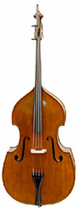
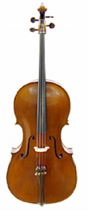
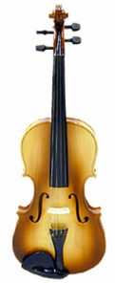
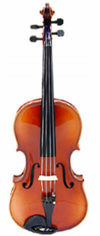
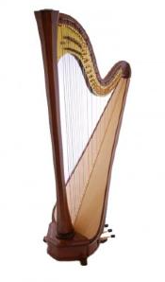
String instruments
Violin
Viola
Cello
Double bass
Harp

Slide 2
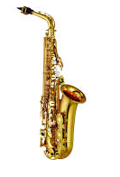



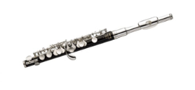


Woodwind Instruments
Recorder
Piccolo
Flute
Oboe
Clarinet
Bassoon
Saxophone

Slide 3
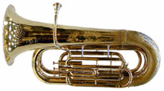
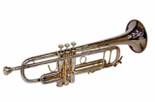
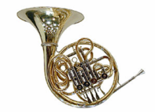
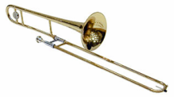
Brass instruments
Trumpet
Trombone
French Horn
Tuba

Slide 4
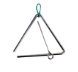

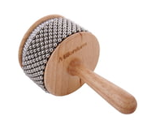

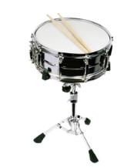
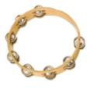
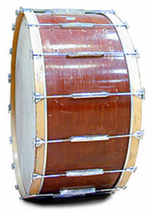
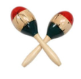
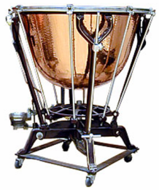
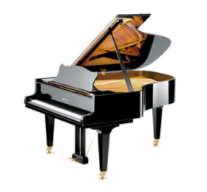
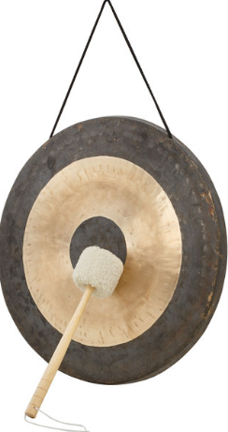
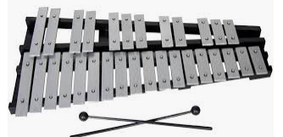
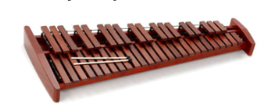
Triangle
Percussion instruments
cymbals
Cabasa
claves
tambourine
Snare drum
maracas
Bass drum
timpani
tamtam
piano
xylophone
Glockenspiel

Slide 5
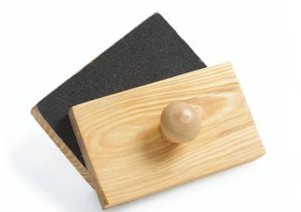
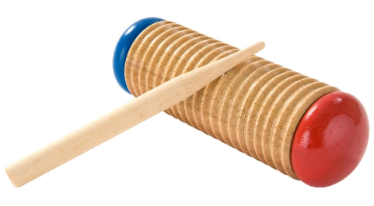
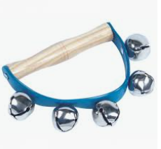
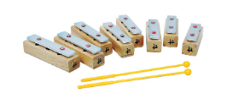
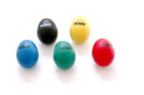
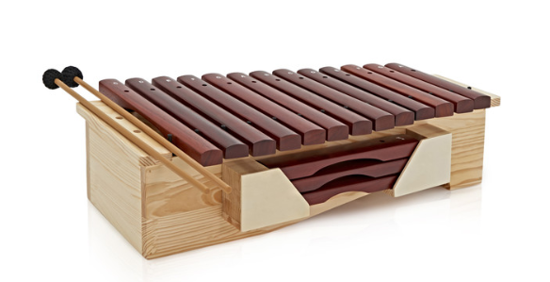
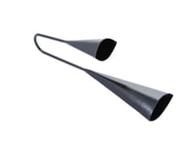
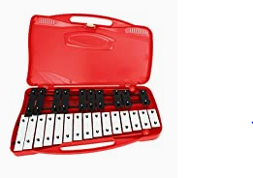
Percussion instruments used in school
Tambourine
Sand blocks
Guiro
maracas
Bells
Egg shakers
Claves
Cabasa
Chime bars
Glockenspiel
Agogo bells
Triangle
Xylophone

Slide 6
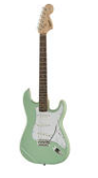
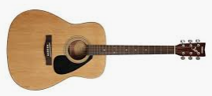
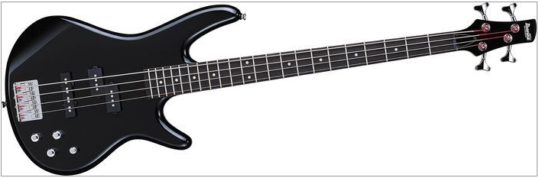
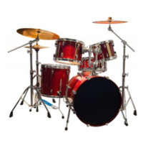
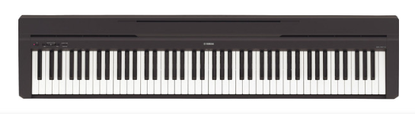
Band Instruments
Acoustic guitar
Electric guitar
Electric bass guitar
Drum kit
Electric piano/keyboard

Slide 7
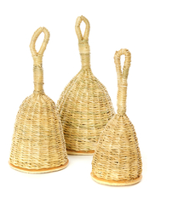
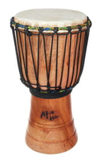
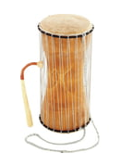
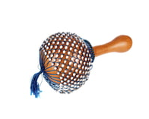
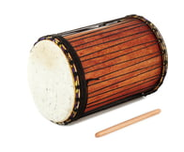
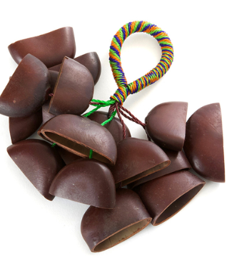
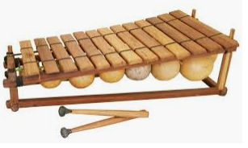
African Instruments
Basket
shaker
djembe
Talking drum
cabasa
dundun
Seed pod
shaker
balafon

Slide 8
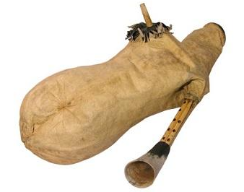


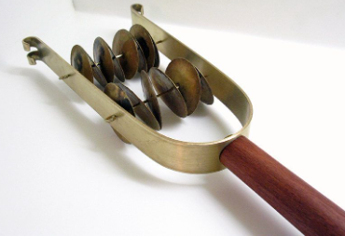
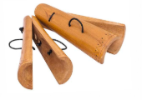
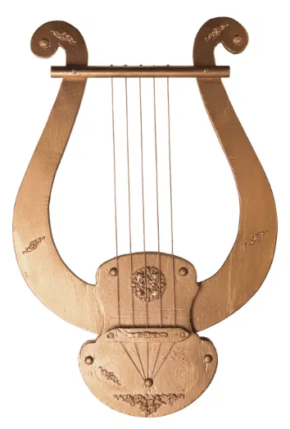
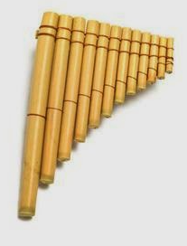
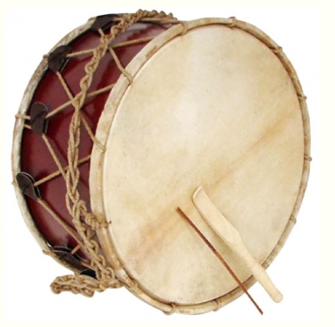
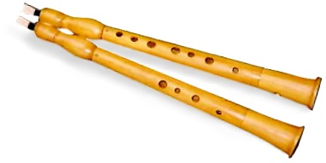
Greek Instruments
Kymbala
(symbals)
Askaulos
(bagpipe)
Sistrum
(rattle)
Psithyra
(xylophone)
Kratala
(clappers)
Tympanon
(shallow drum)
lyre
Aulos
syrinx

Slide 9
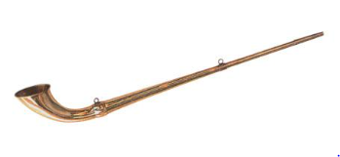






Roman Instruments
castinets
Tuba
lute
Cornu
(horn)
Pan’s
flute
Sistrum
(rattle)
Flutes
with reed
flute
lyra

Slide 10





Egyptian Instruments
Flute
with reed
lute
flute
lyra
Sistrum
(rattle)
trumpets
harp

Slide 11





Syrian Instruments
Kemenjah
(Spike fiddle)
Oud
Daf
(tambourine)
Qanun
(box zither)
Darabukkah
(goblet drum)

