Slide 1
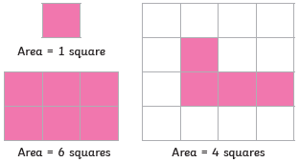
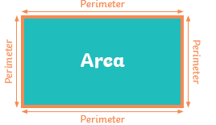




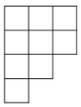
Templars Primary School – Knowledge Organiser
Year 4 Area, Perimeter and Length
Key Vocabulary
area
perimeter
centimetres
metres
squares
distance
millimetres
kilometres
length
width
rectilinear
right angle
Area and perimeter
Counting squares
Area is the amount of space inside a shape.
Perimeter is the total distance around the outside of a 2D shape
We can count squares to find the area of rectilinear shapes.
Making shapes
Compare area
A rectilinear shape is a 2D shape whose sides all meet at a right angle (90 degrees).
We can make rectilinear shapes using a given number of squares as their area.
is less than
<
is greater than
>

